Slide 1



Slide 2


Data Warehouse
Dashboard with metrics y KPI´s
Alcance

Slide 3
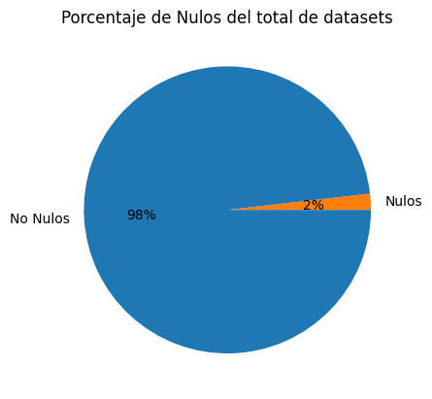

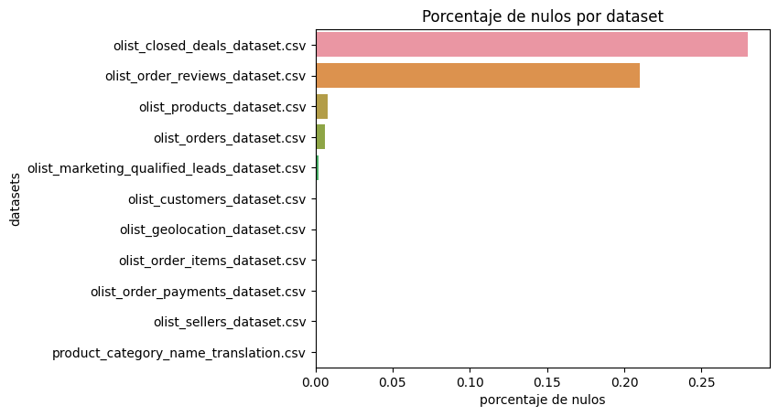
Report

Slide 4

Analysis of the geografic zones where there’s not so much sellers and that could be.
Solution

Slide 5





Company

Slide 6



Slide 7




Mission

Slide 8



Vision

Slide 9




Values

Slide 10

Expand the Olist’s customers impact-range to geolocations that are not being exploited.
Objective

Slide 11

Annual behavior of the geolocations
Evolution of the annual customers quantity
Quantity and percentage of the frequent clients by year
KPI´s
Comparison evolution quantity of sales

Slide 12

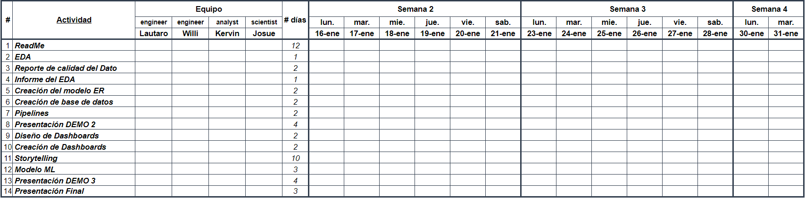
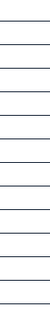
Gantt’s diagram

Slide 13







Stack

Slide 14
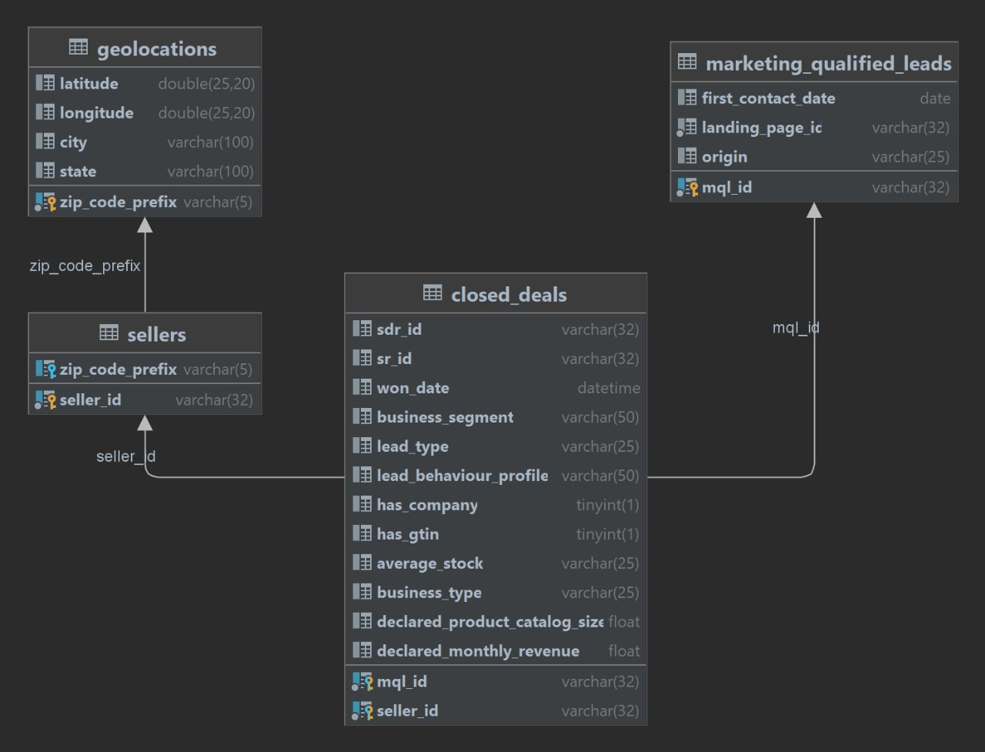

Slide 15
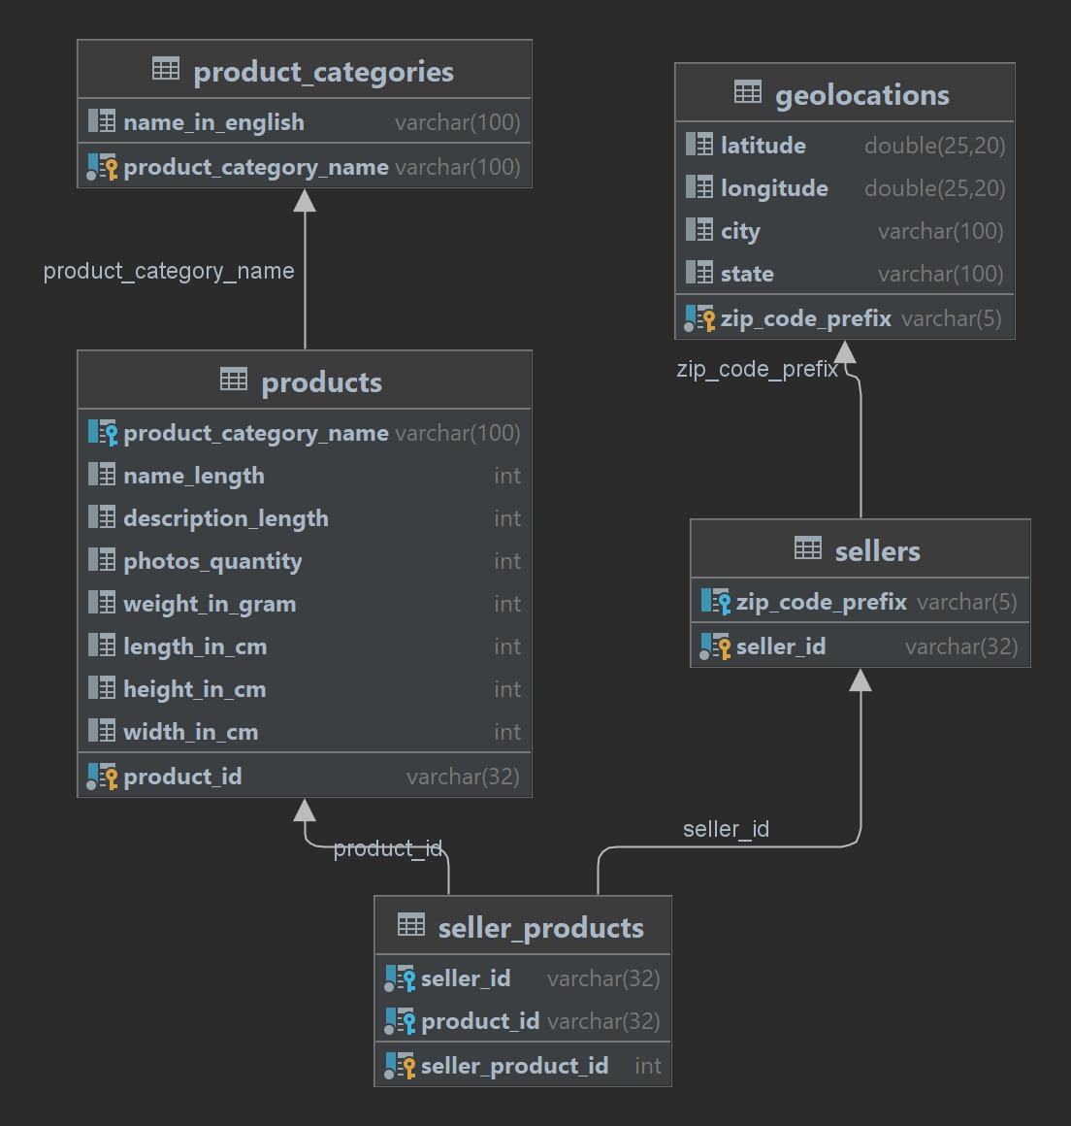

Slide 16
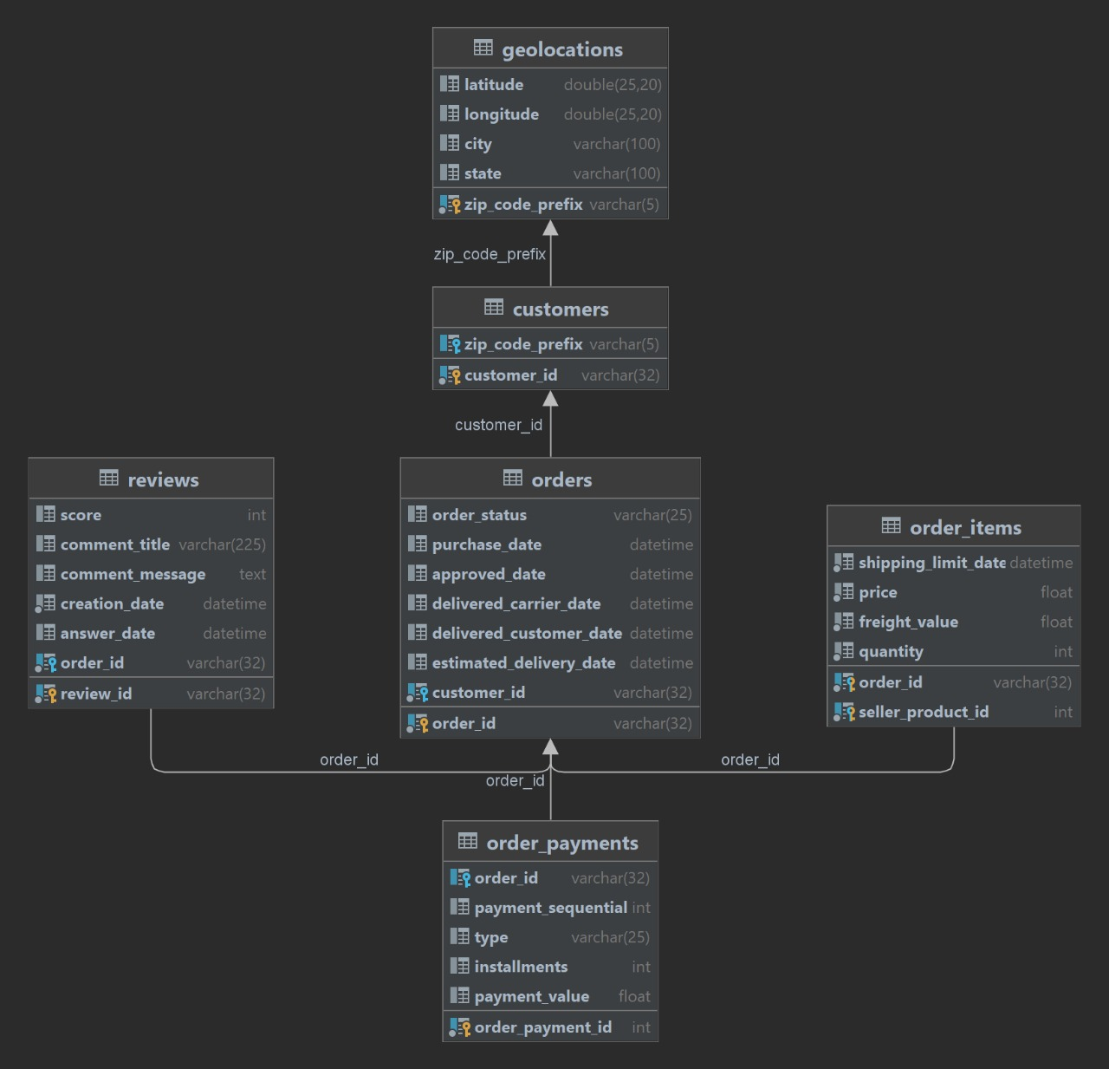

Slide 17
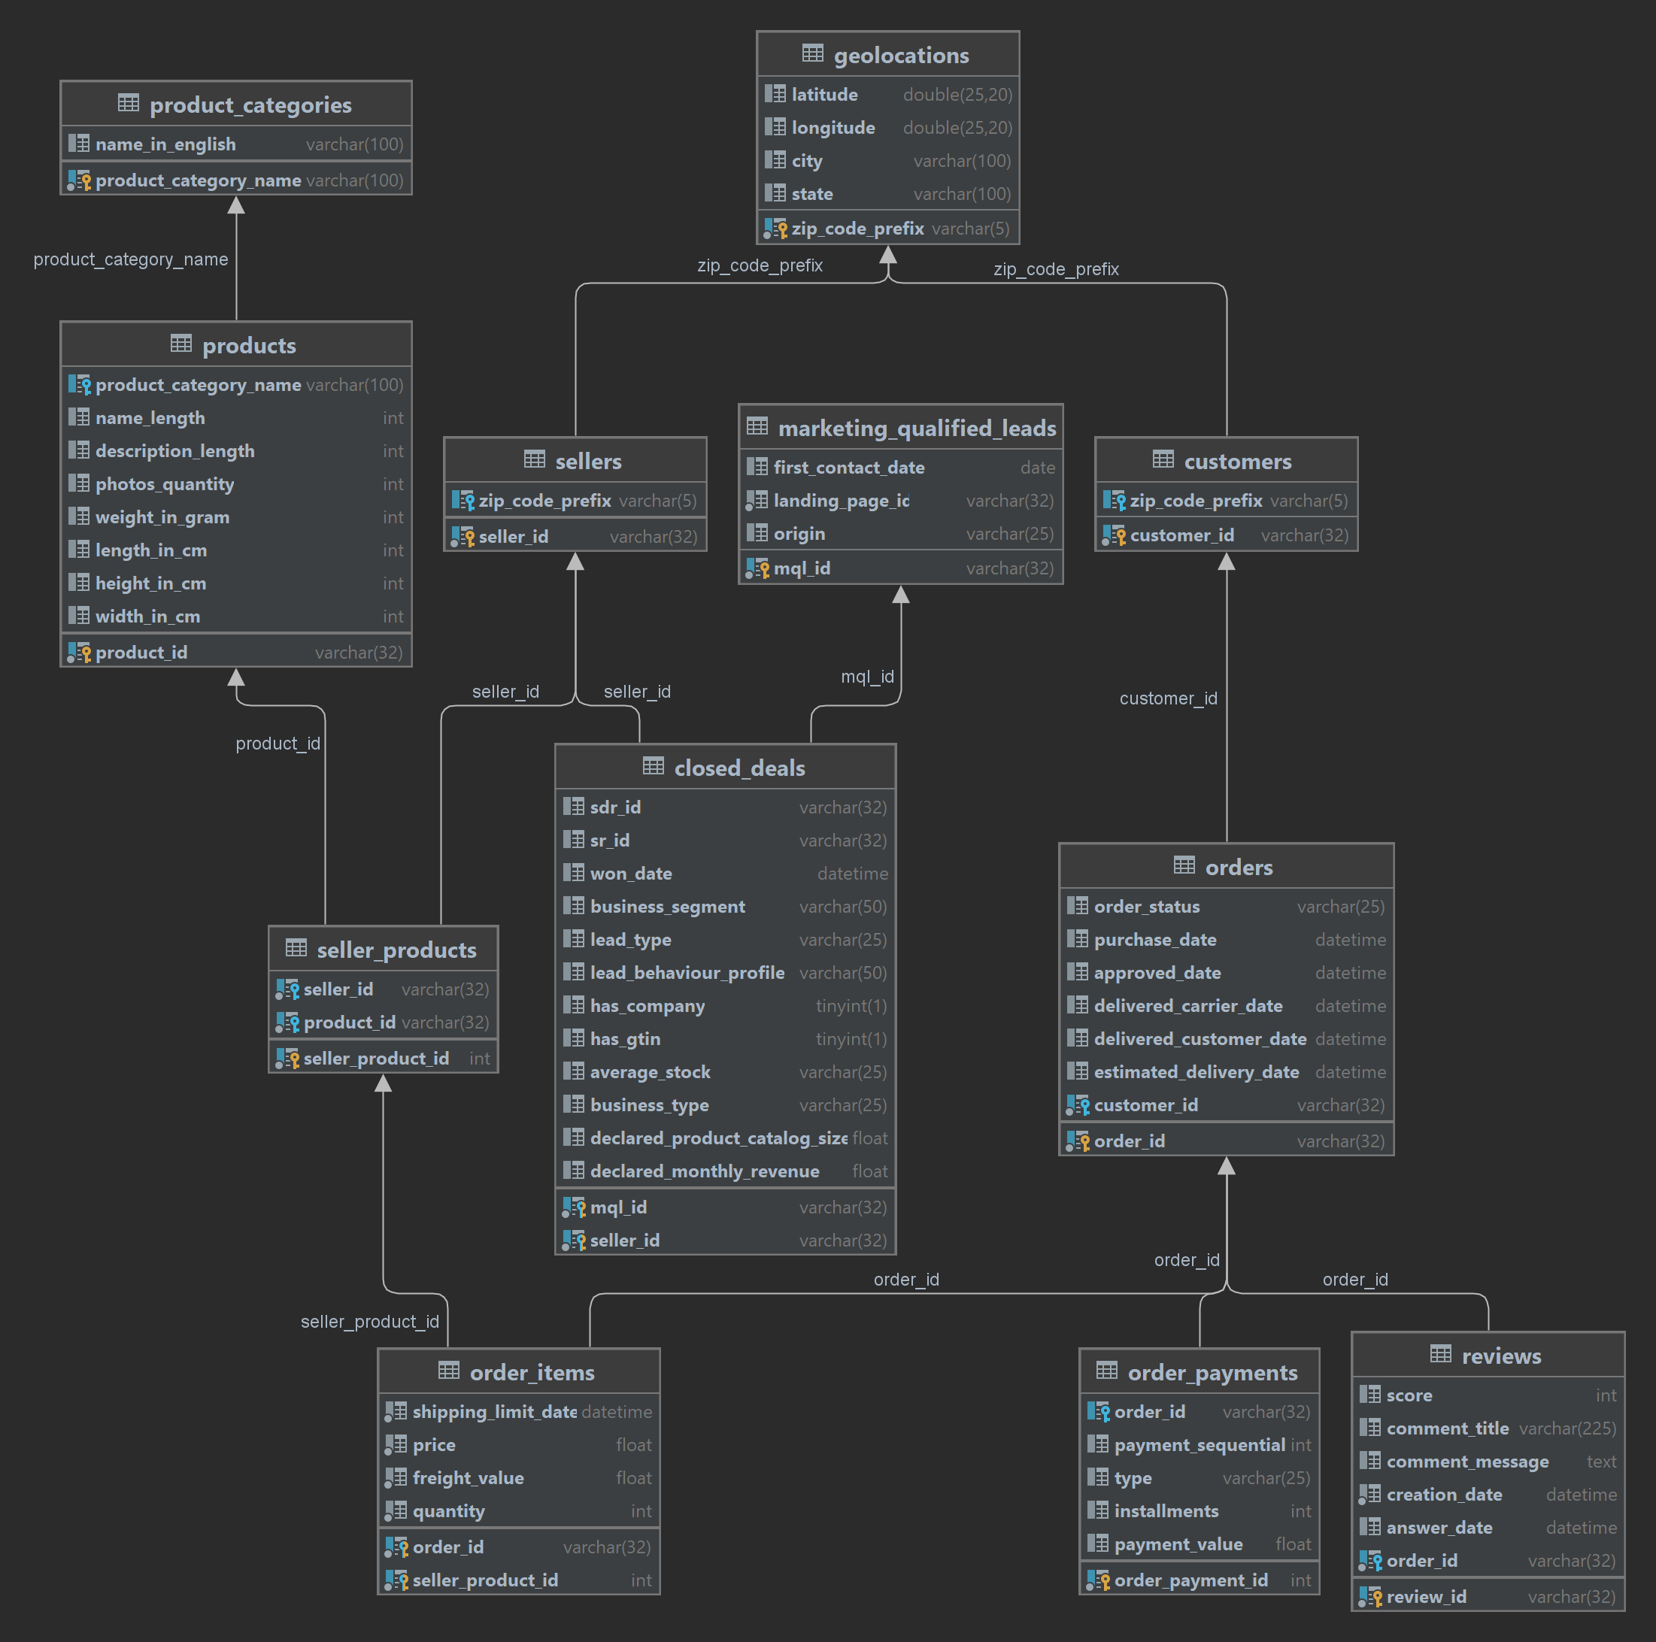

Slide 18

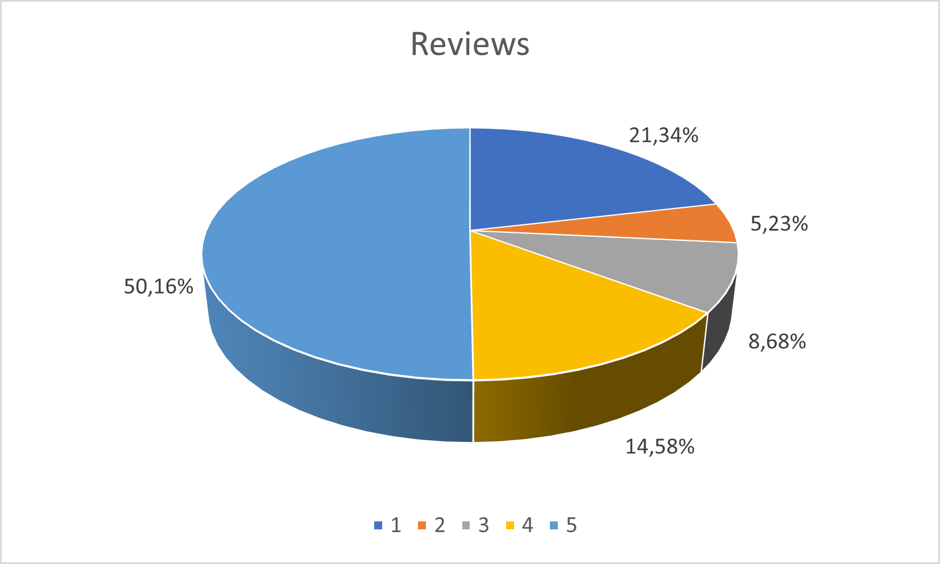



Positive tendency
Reviews

Slide 19

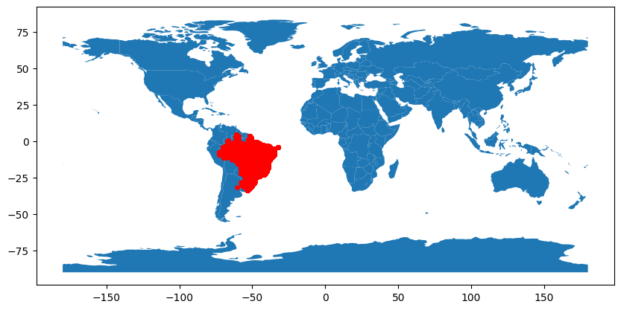

Geolocations

Slide 20
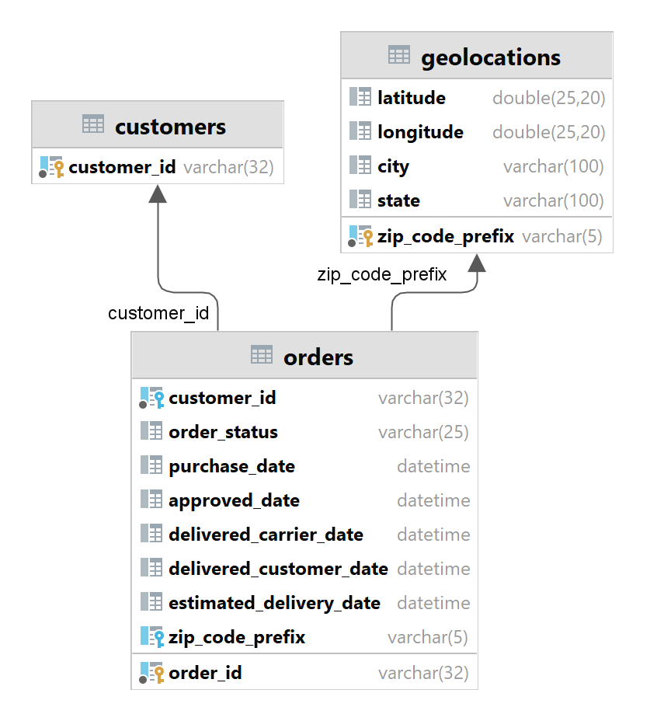


Incremental loads

Slide 21








Data Preprocessing
Automatization
Raw Data
ETL
Clean Data
Create DB

Slide 22
Continue to the Dashboard…

